Slide 1
Computer Architecture Experiment
Topic 6. Dynamically Scheduled Pipelines using Scoreboarding
浙江大学计算机学院
2021年9月

Slide 2
Outline
Experiment Purpose
Experiment Task
Basic Principle
Operating Procedures
Checkpoints

Slide 3
Experiment Purpose
Understand the principle of piplines that support multicycle operations.
Understand the principle of Dynamic Scheduling With a Scoreboard.
Master the design methods of piplines that support multicycle operations.
Master the design methods of Dynamically Scheduled Pipelines using Scoreboarding.
Master verification methods of Dynamically Scheduled Pipelines using Scoreboarding.

Slide 4
Experiment Task
Redesign the pipelines with IF/IS/RO/FU/WB stages and supporting multicycle operations.
Design of a scoreboard and integrate it to CPU.
Verify the Pipelined CPU with program and observe the execution of program.

Slide 6
Instr. Mem.(1)
NO. | Instruction | Addr. | Label | ASM | Comment
0 | 00000013 | 0 | __start: | addi x0, x0, 0
1 | 00402103 | 4 |  | lw x2, 4(x0)
2 | 00802203 | 8 |  | lw x4, 8(x0) | Structural Hazard
3 | 004100b3 | C |  | add x1, x2, x4
4 | fff08093 | 10 |  | addi x1, x1, -1 | WAW
5 | 00c02283 | 14 |  | lw x5, 12(x0)
6 | 01002303 | 18 |  | lw x6, 16(x0)
7 | 01402383 | 1C |  | lw x7, 20(x0)
8 | 402200b3 | 20 |  | sub x1,x4,x2
9 | ffd50093 | 24 |  | addi x1,x10,-3
10 | 00520c63 | 28 |  | beq x4,x5,label0
11 | 00420a63 | 2C |  | beq x4,x4,label0
12 | 00000013 | 30 |  | addi x0,x0,0
13 | 00000013 | 34 |  | addi x0,x0,0
14 | 00000013 | 38 |  | addi x0,x0,0

Slide 7
Instr. Mem.(2)
NO. | Instruction | Addr. | Label | ASM | Comment
15 | 00000013 | 3C |  | addi x0,x0,0
16 | 000040b7 | 40 | label0: | lui x1,4
17 | 00c000ef | 44 |  | jal x1,12
18 | 00000013 | 48 |  | addi x0,x0,0
19 | 00000013 | 4C |  | addi x0,x0,0
20 | ffff0097 | 50 |  | auipc x1, 0xffff0
21 | 0223c433 | 54 |  | div x8, x7, x2
22 | 025204b3 | 58 |  | mul x9, x4, x5
23 | 022404b3 | 5C |  | mul x9, x8, x2 | St. Ha./RAW/WAW
24 | 00400113 | 60 |  | addi x2, x0, 4 | WAR
25 | 000000e7 | 64 |  | jalr x1,0(x0)
26 | 00000013 | 68 |  | addi x0,x0,0
27 | 00000013 | 6C |  | addi x0,x0,0

Slide 8
Data Mem.
NO. | Data | Addr. | Comment
0 | 000080BF | 0
1 | 00000008 | 4
2 | 00000010 | 8
3 | 00000014 | C
4 | FFFF0000 | 10
5 | 0FFF0000 | 14
6 | FF000F0F | 18
7 | F0F0F0F0 | 1C
8 | 00000000 | 20
9 | 00000000 | 24
10 | 00000000 | 28
11 | 00000000 | 2C
12 | 00000000 | 30
13 | 00000000 | 34
14 | 00000000 | 38
15 | 00000000 | 3C
NO. | Instruction | Addr. | Comment
16 | 00000000 | 40
17 | 00000000 | 44
18 | 00000000 | 48
19 | 00000000 | 4C
20 | A3000000 | 50
21 | 27000000 | 54
22 | 79000000 | 58
23 | 15100000 | 5C
24 | 00000000 | 60
25 | 00000000 | 64
26 | 00000000 | 68
27 | 00000000 | 6C
28 | 00000000 | 70
29 | 00000000 | 74
30 | 00000000 | 78
31 | 00000000 | 7C

Slide 9
Test Bench
RV32core core(
.debug_en(1'b0),
.debug_step(1'b0),
.debug_addr(7'b0),
.debug_data(),
.clk(clk),
.rst(rst),
.interrupter(1'b0)
);
initial begin
clk = 0;
rst = 1;
#2 rst = 0;
end
always #1 clk = ~clk;

Slide 10
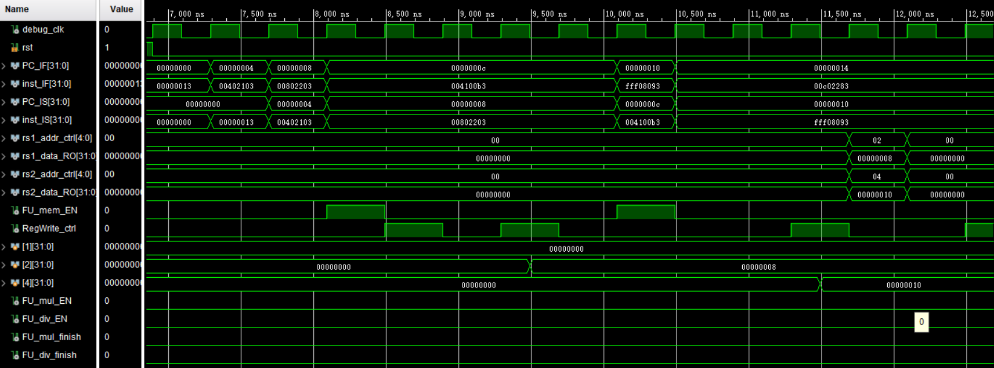
Simulation (1)

Slide 11
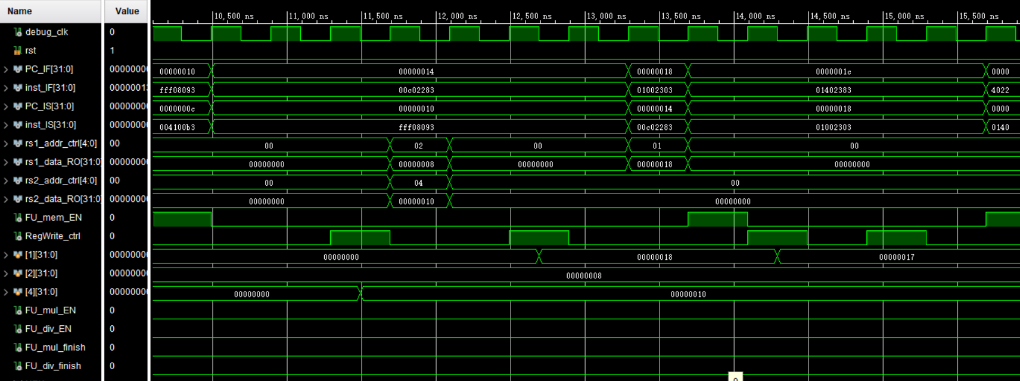
Simulation (2)

Slide 12
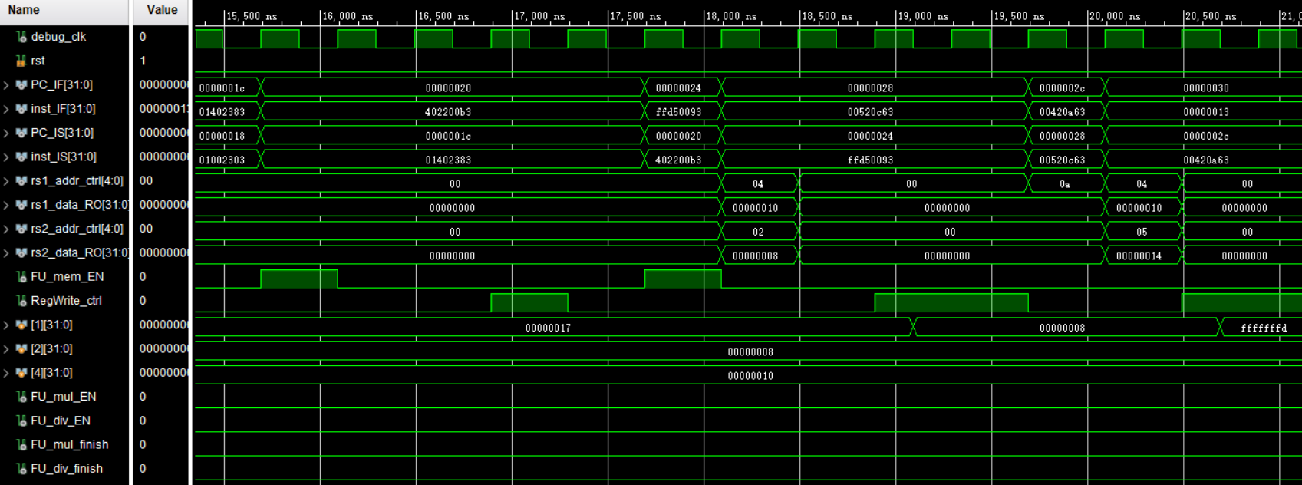
Simulation (3)

Slide 13
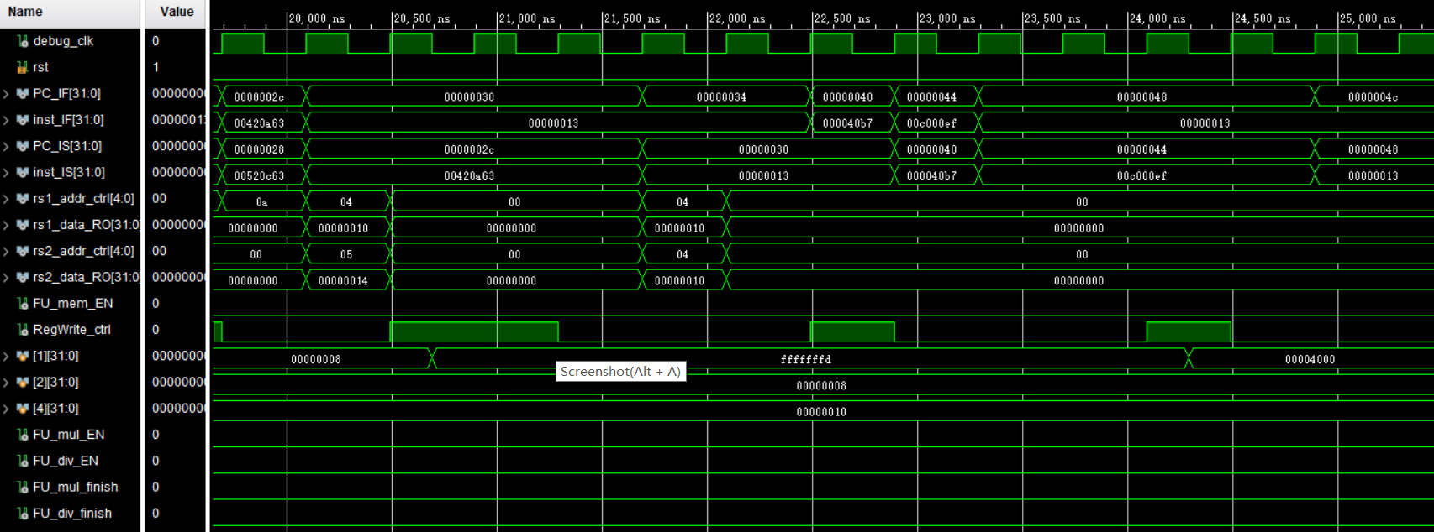
Simulation (4)

Slide 14
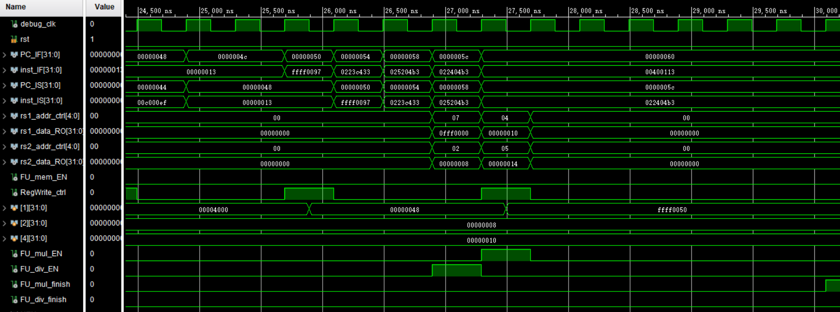
Simulation (5)

Slide 15
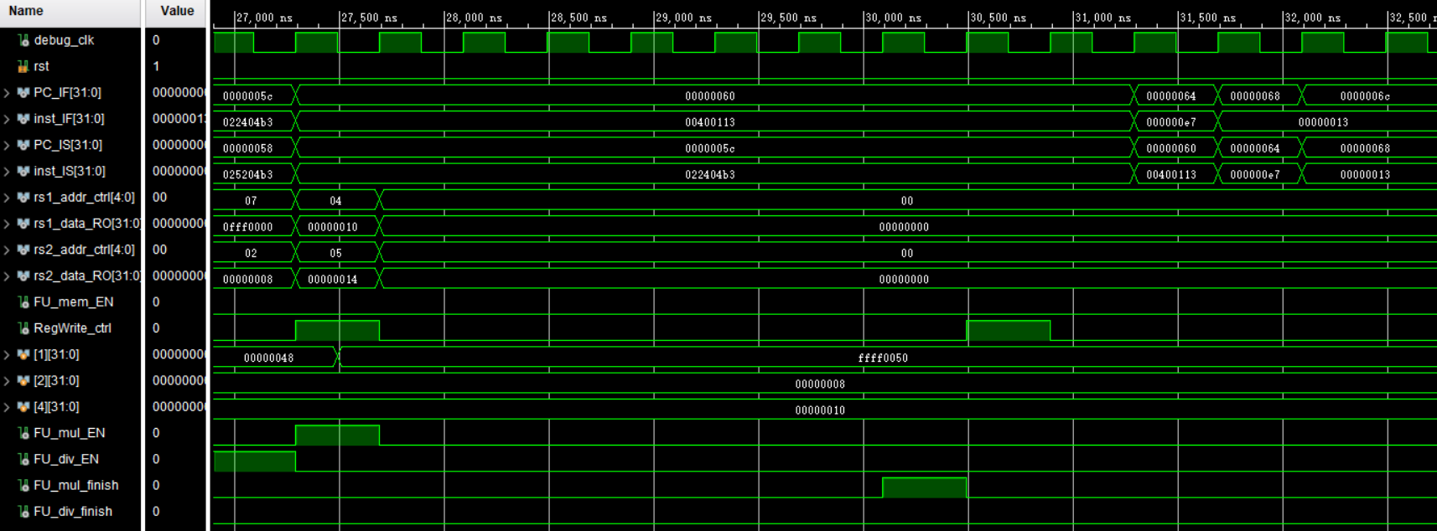
Simulation (6)

Slide 16
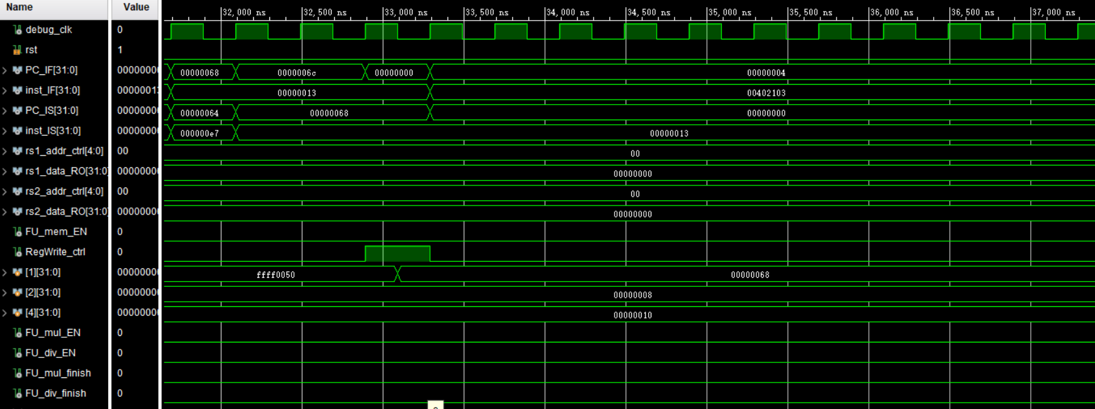
Simulation (7)

Slide 17
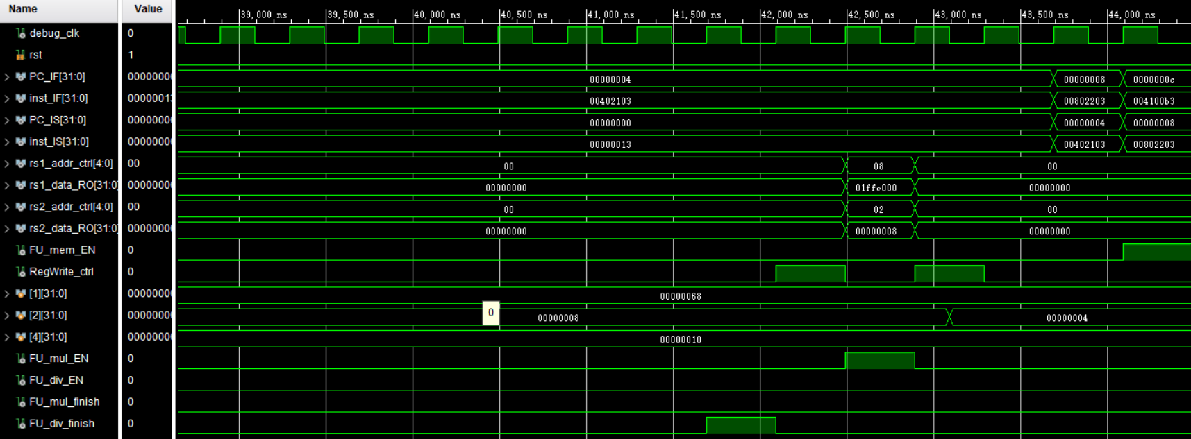
Simulation (8)

Slide 18
Checkpoints
CP 1:
Waveform Simulation of the Pipelined CPU with the verification program
CP 2:
FPGA Implementation of the Pipelined CPU with the verification program

Slide 19
Thanks!

